Slide 1
Over-view of the environment

Slide 2
Environment
Environment Manager
Game grid
Take action
Reset
Process screen
Crop screen
Trans screen
Get state
step
Set-up
Get window
update
Add zombie
Draw grid
Place zombie
Move zombie
Transfer agents actions
Create pygame window
Remove zombie
Match screen to network

Slide 3
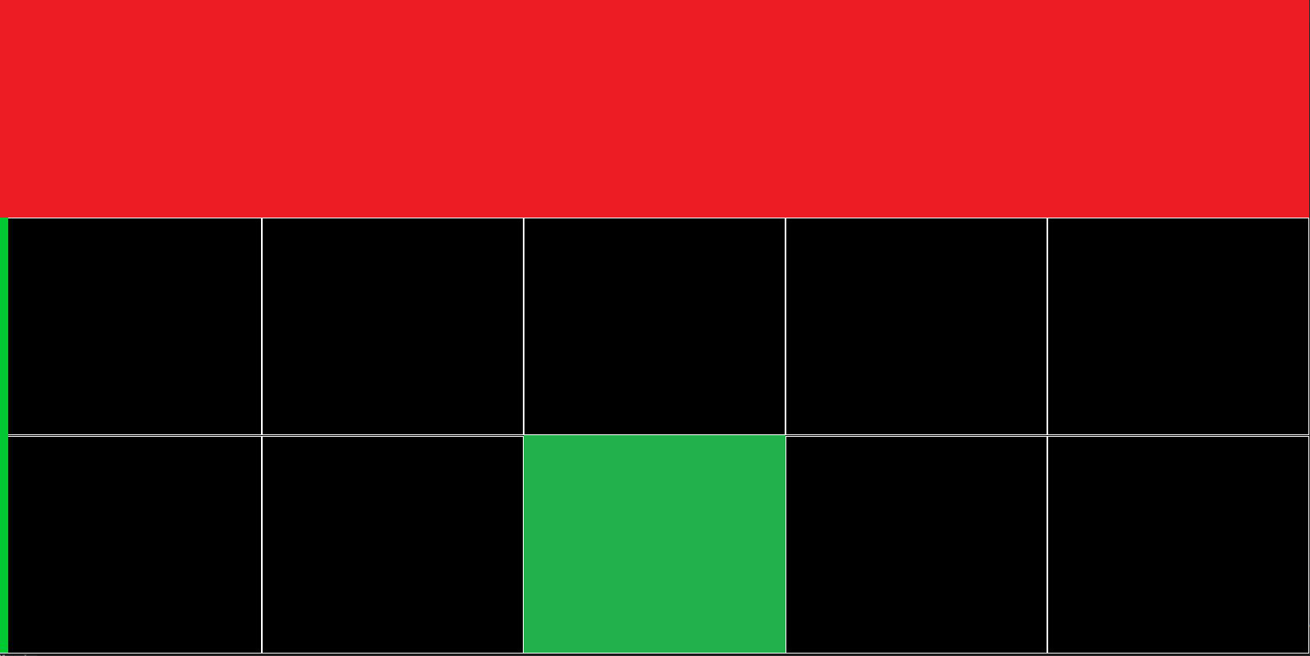
0
1
2
3
4
5
6
7
8
9
10
11
12
13
14

Slide 4
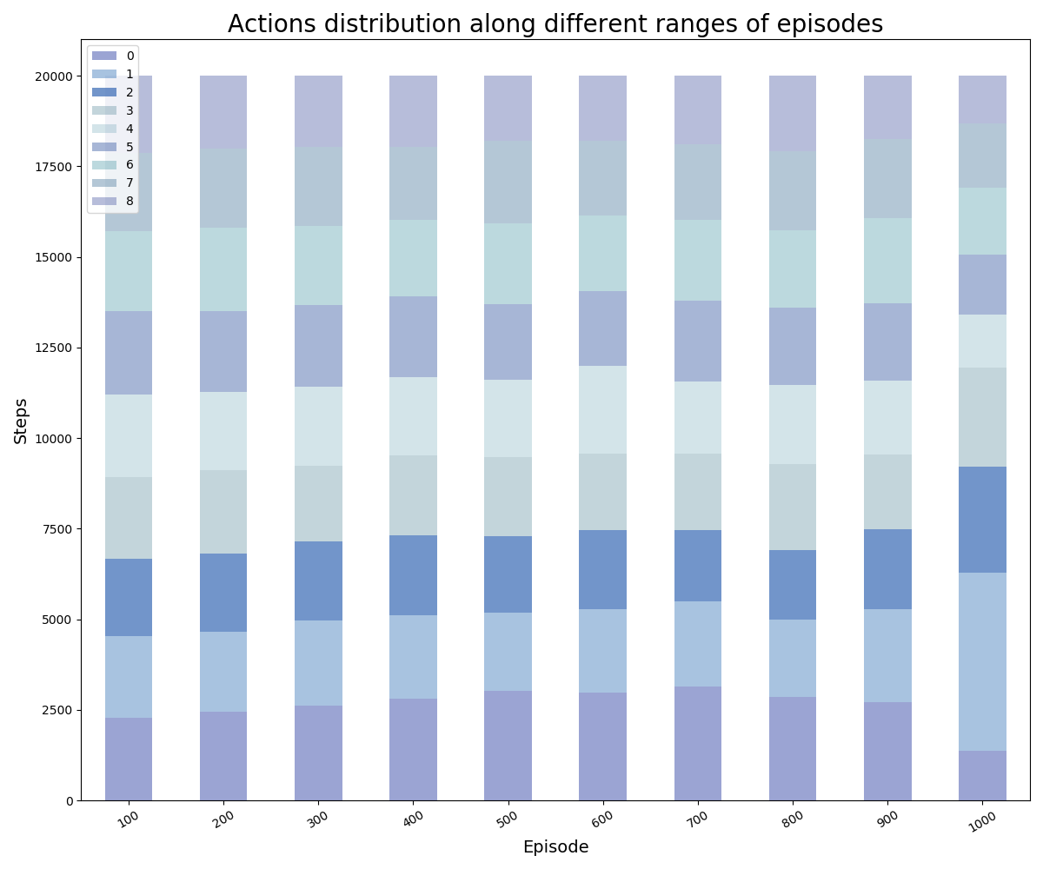
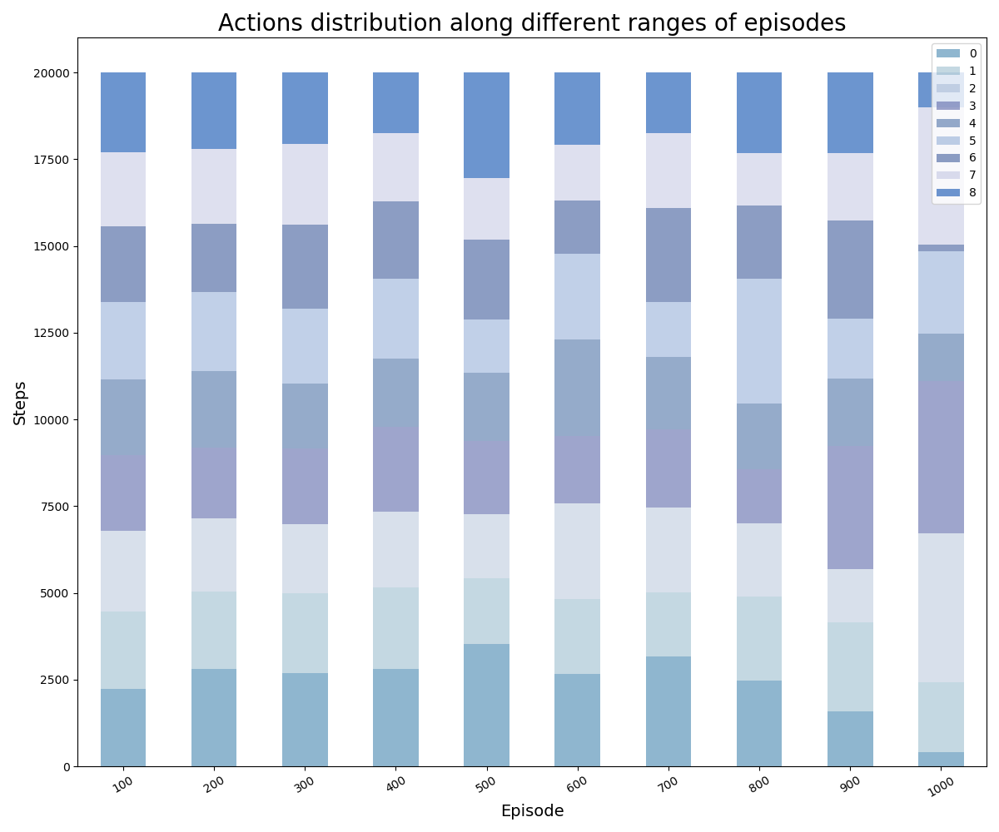
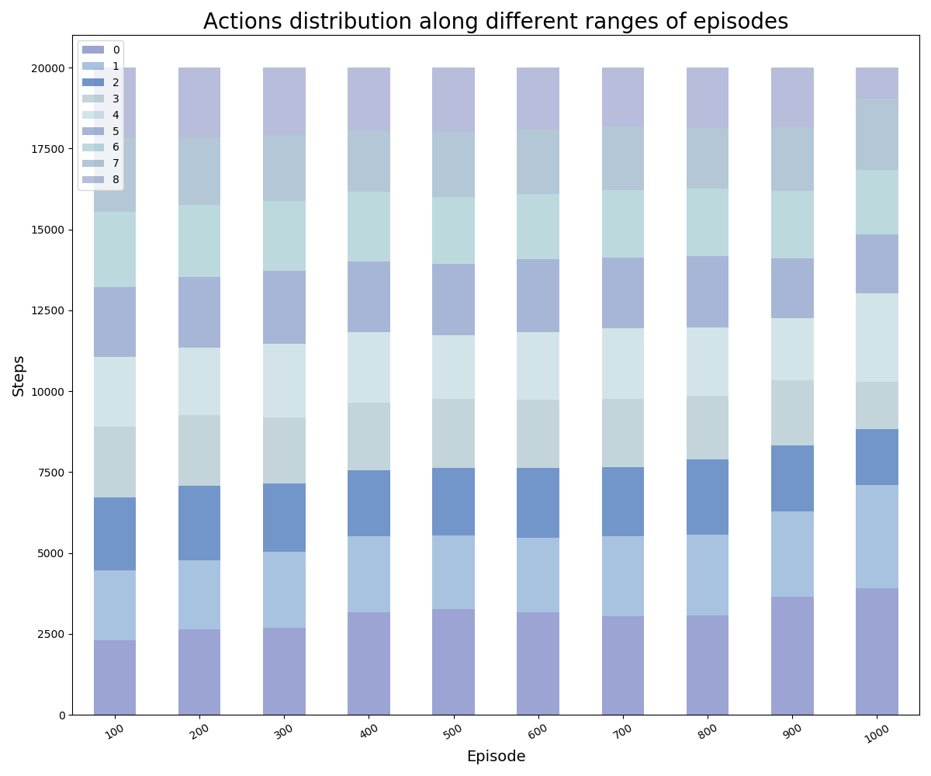
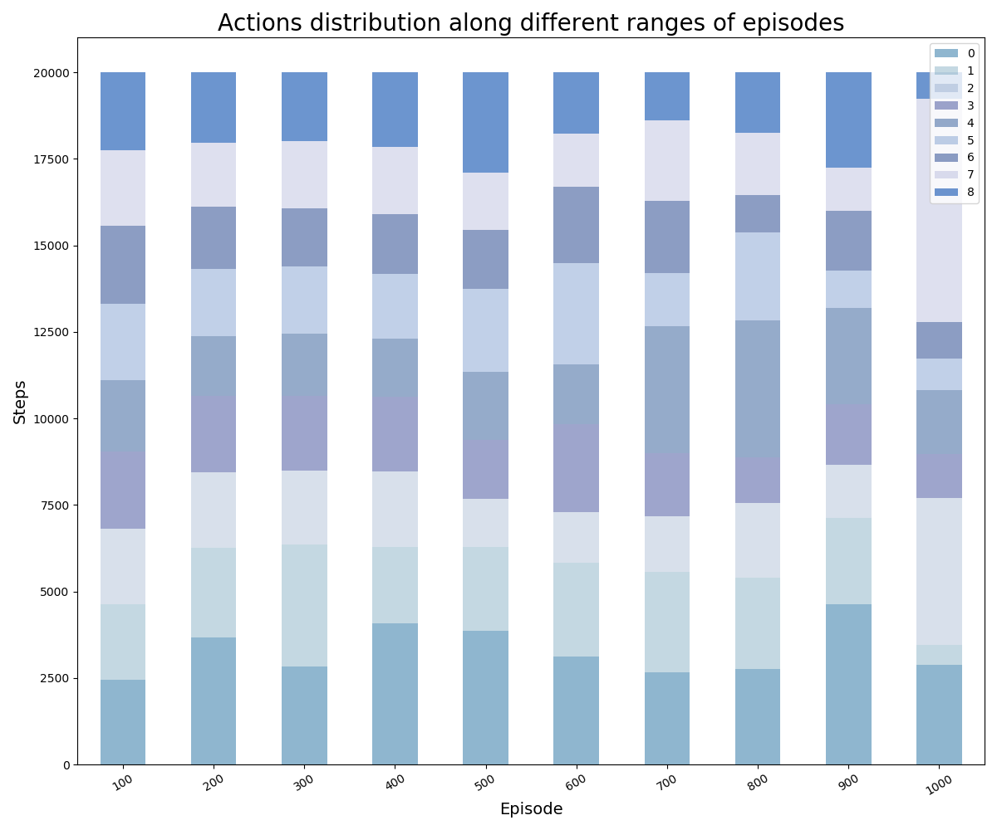
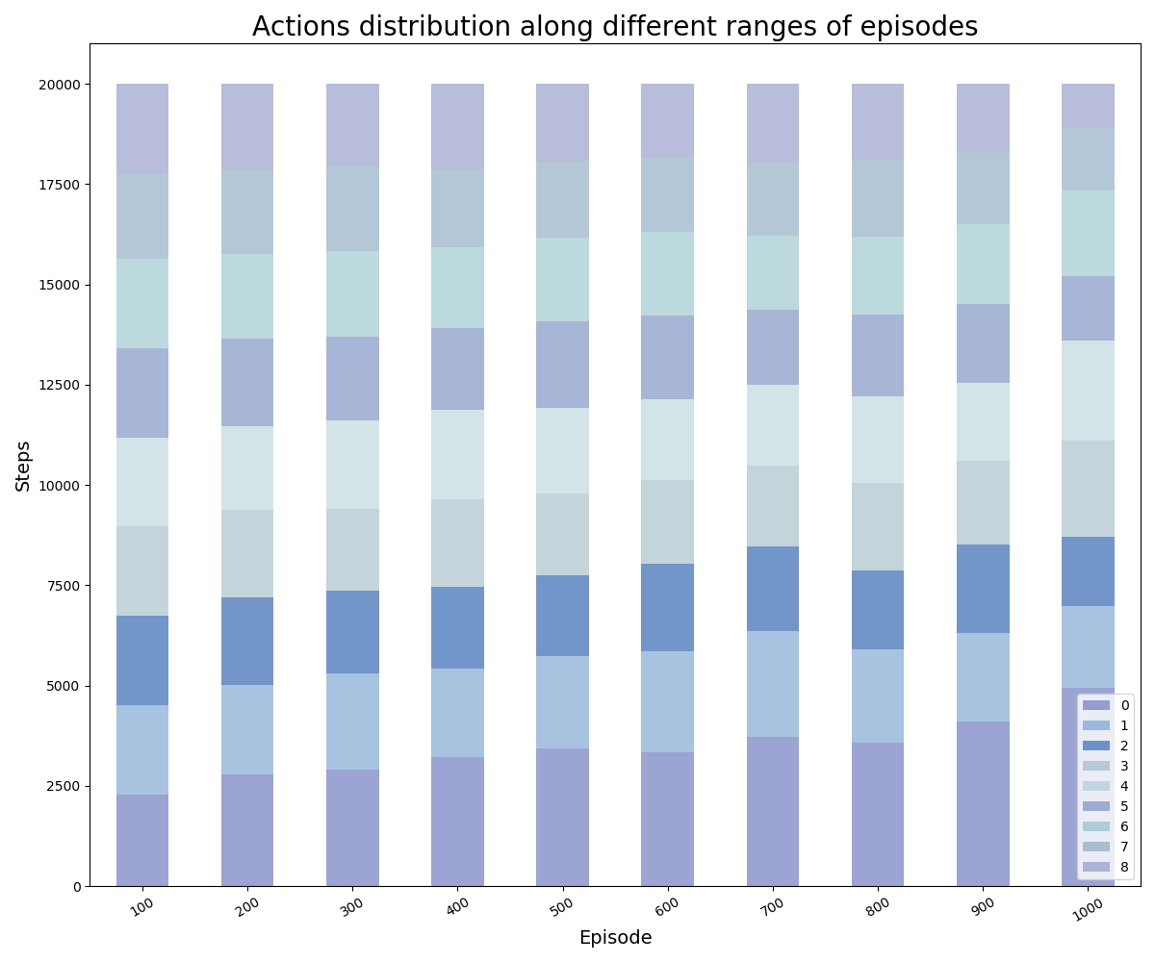
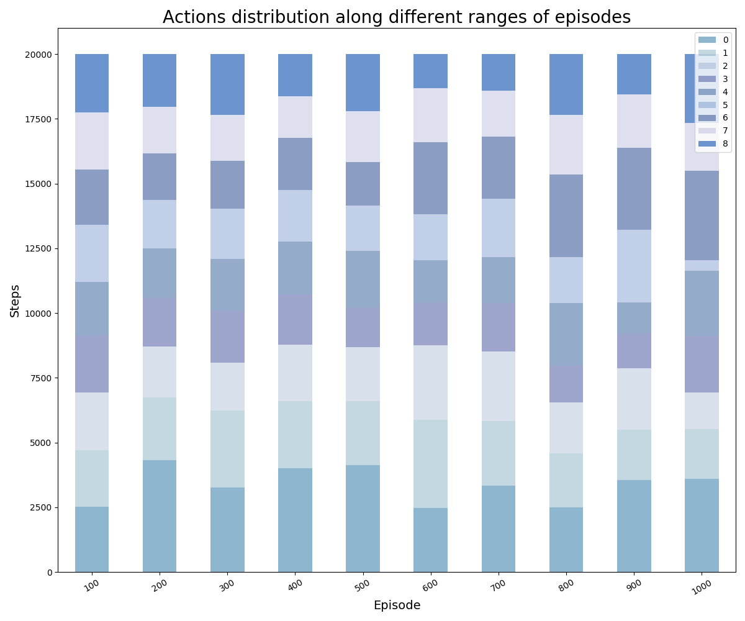
Light size = 3
Light size = 4
Light size = 5
Light actions histogram
Zombie actions histogram

Slide 5
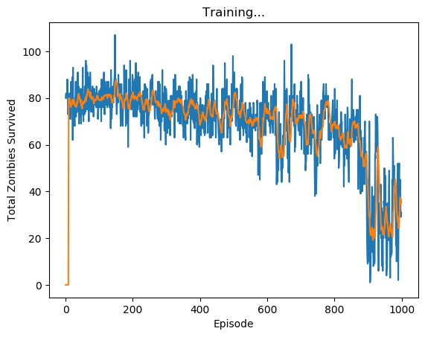
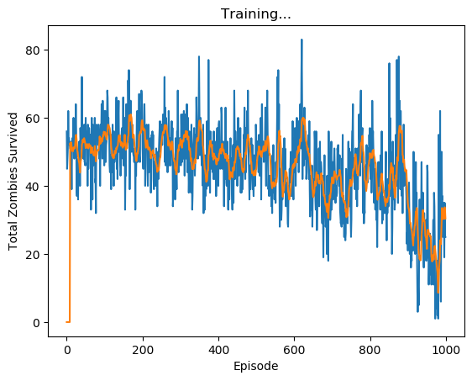
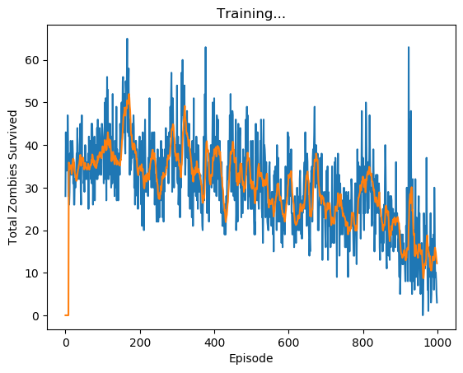
Light size = 3
Light size = 4
Light size = 5

Slide 6
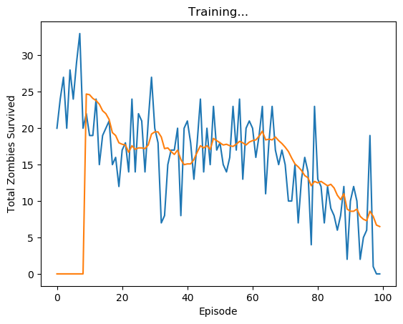
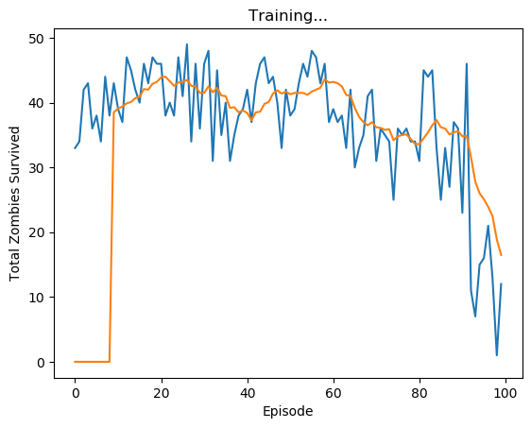
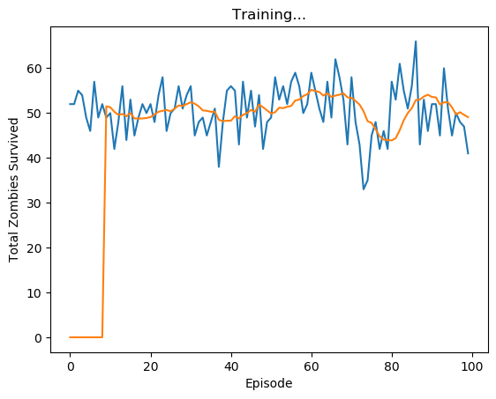
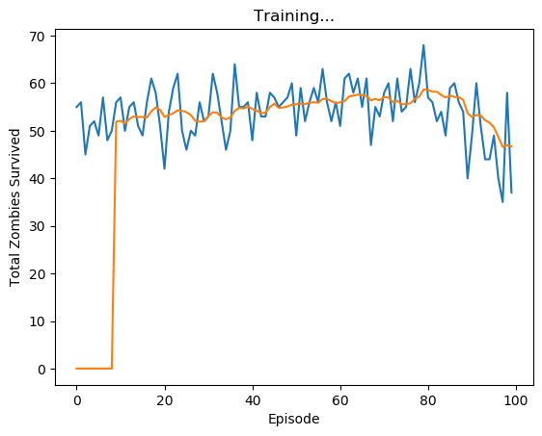
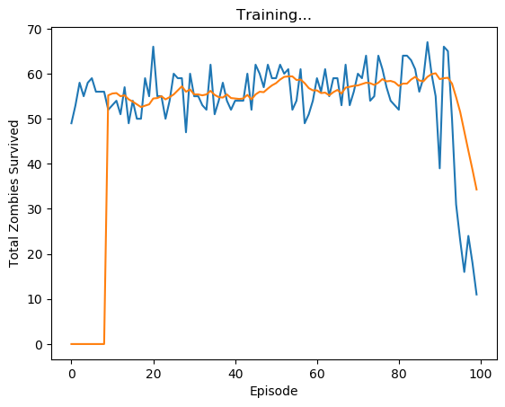
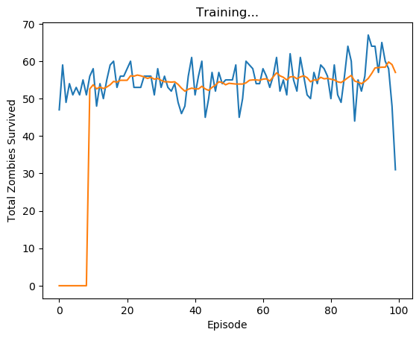
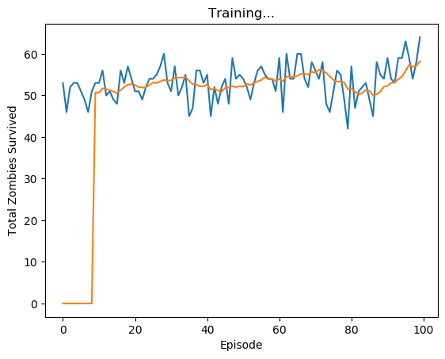
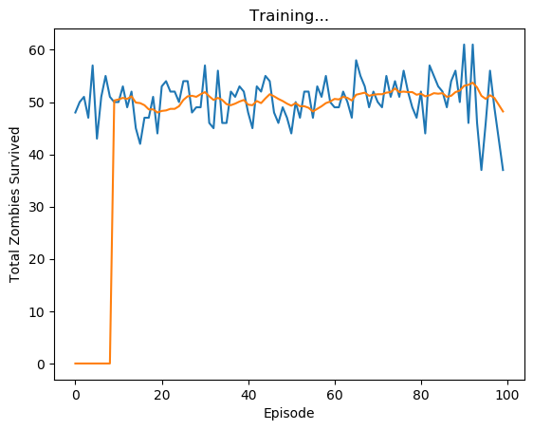
Board size = 5,10
Board size = 15,20
Board size = 25,30
Board size = 35,40

